Slide 1
Raspberry Pi controlled using Python
Course Instructor: Dr. Mahmoud El Samanty
Teaching Assistant: Eng. Hosam Hassan
Hedaya Ali (ID 171103)
Mohd Saiful Akmal Bin Razali (ID 171021)
Gabriel de Brito Silva (ID 171020)
Berit Adina Haendel (ID 171018)
Team Members
2/1/2018
Raspberry Pi controlled using Python

Slide 2
Introduction
Installation and software preparation.
GPIO Application
LED Blinking
Analog input /output.
Motor Control
Communication protocol.

Slide 3
Installation and software preparation

Slide 4
Application 1: LED Blinking
Learning Outcomes:
Construct a basic electrical circuit & attach to GPIO pins.
Write Python codes to control the circuit using IDLE IDE .

Slide 5
LED Blinking - Components
Raspberry Pi configured with GPIO library.
1 LED
1 Resistor
Breadboard
Cables

Slide 6
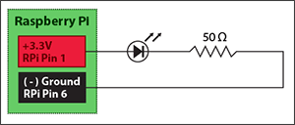
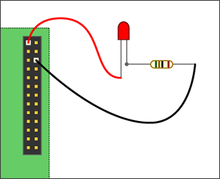
LED Blinking
Aim 1: To simply lighting the led using the 3.3v pin and the ground pin on our RPi.
Connect LED Anode (+ve) to always ON 3.3V RPi Pin 1. This pin provides a steady supply of 3.3v. Pin1is not programmable, and cannot be controlled by software.
Connect Pin 6 with resistor.

Slide 7

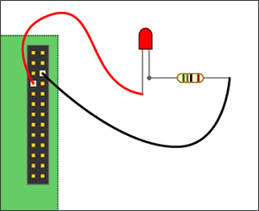

LED Blinking
Aim 2: Controlling LED with Python
Power off RPi. Move the positive lead from Pin 1 to Pin 7.
Power on your RPi and boot all the way into the operating system GUI
Open the terminal and launch the IDLE IDE as a superuser:
Wait for IDLE to open, then click File > New to open a new window (Ctrl + N).
Click File > Save when you are done (Ctrl + S).
To run your program, click Run > Run (Ctrl + F5)

Slide 8
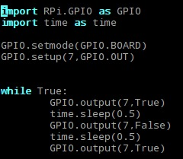
LED Blinking
Aim 3: To blink a LED
Steps are the same with Aim 2. We just need to code more with Python.
## Import GPIO library
## Import ‘time’ library. Allows us to use ‘sleep’.
## Use board pin numbering
## Setup GPIO Pin 7 to OUT
## Switch on pin 7
## Wait for 0.5sec
## Switch off pin 7
## Wait for 0.5sec
## Switch on pin 7

Slide 9
Analog input /output [Motor Control]

Slide 10
Communication protocol

